Slide 1
Physics-Informed Extreme Theory of Functional Connections for Parametric ODEs and PDEs
Enrico Schiassi (PhD Student), Roberto Furfaro (Advisor)
eschiassi@email.arizona.edu
Los Alamos – Arizona Days
May 18th -19th 2020

Slide 2
Contents
  Introduction
    Overview
    Goals
  Extreme Theory of Functional Connection
    Method
    Constrained Expression
    Extreme Learning Machine Algorithm
  Results and Discussion
    ODEs
    PDEs
  Conclusions and Outlooks

Slide 3
Contents
  Introduction
    Overview
    Goals
  Extreme Theory of Functional Connection
    Method
    Constrained Expression
    Extreme Learning Machine Algorithm
  Results and Discussion
    ODEs
    PDEs
  Conclusions and Outlooks

Slide 4






Introduction: Overview & Motivations
  Many real-world problems are modeled via parametric Differential Equations (DEs)
    Physics, engineering, finance, biology, chemistry, oceanography, etc.
  There is the need to have accurate, fast, robust, and reliable tools to solve parametric DEs
    Forward problems
      Direct problems
      Data-driven solution
    Inverse problems
      Data-driven discovery of the parameters governing the DEs

Slide 5
Introduction: New Methods Overview
  The Theory of Functional Connections (TFC) [Mortari, 2017] is a recently developed framework for functional interpolation
    The function is approximated via a constrained expression
      Sum of a free-chosen function and a functional that analytically satisfies the constraints
    TFC is applied to solve parametric DEs
      The free-chosen function is an expansion of orthogonal polynomials (Chebyshev or Legendre)
      The constraints are the Initial/Boundary Conditions (IC or BC)
  The Physics-Informed (PI) Neural Networks (NN) Methods are a novel approach, coming from the Machine Learning community
    The DE latent solutions are approximated via a (Deep) Neural Network (NN), and the DEs drive the NN training
 | Pros | Cons
TFC (w/ OP) | ICs/BCs always analytically satisfied Accurate Solutions Low Computational Time | Non-linear problems can be very sensitive to the initial guesses The use of orthogonal polynomials makes infeasible to apply this method for PDEs
PI | Expanding the latent solution via NN allows to apply this method to solve high order PDEs | Many training points required for high accuracy (ICs/BCs not analytically satisfied) Computational expensive when gradient based methods are used to train the NN

Slide 6
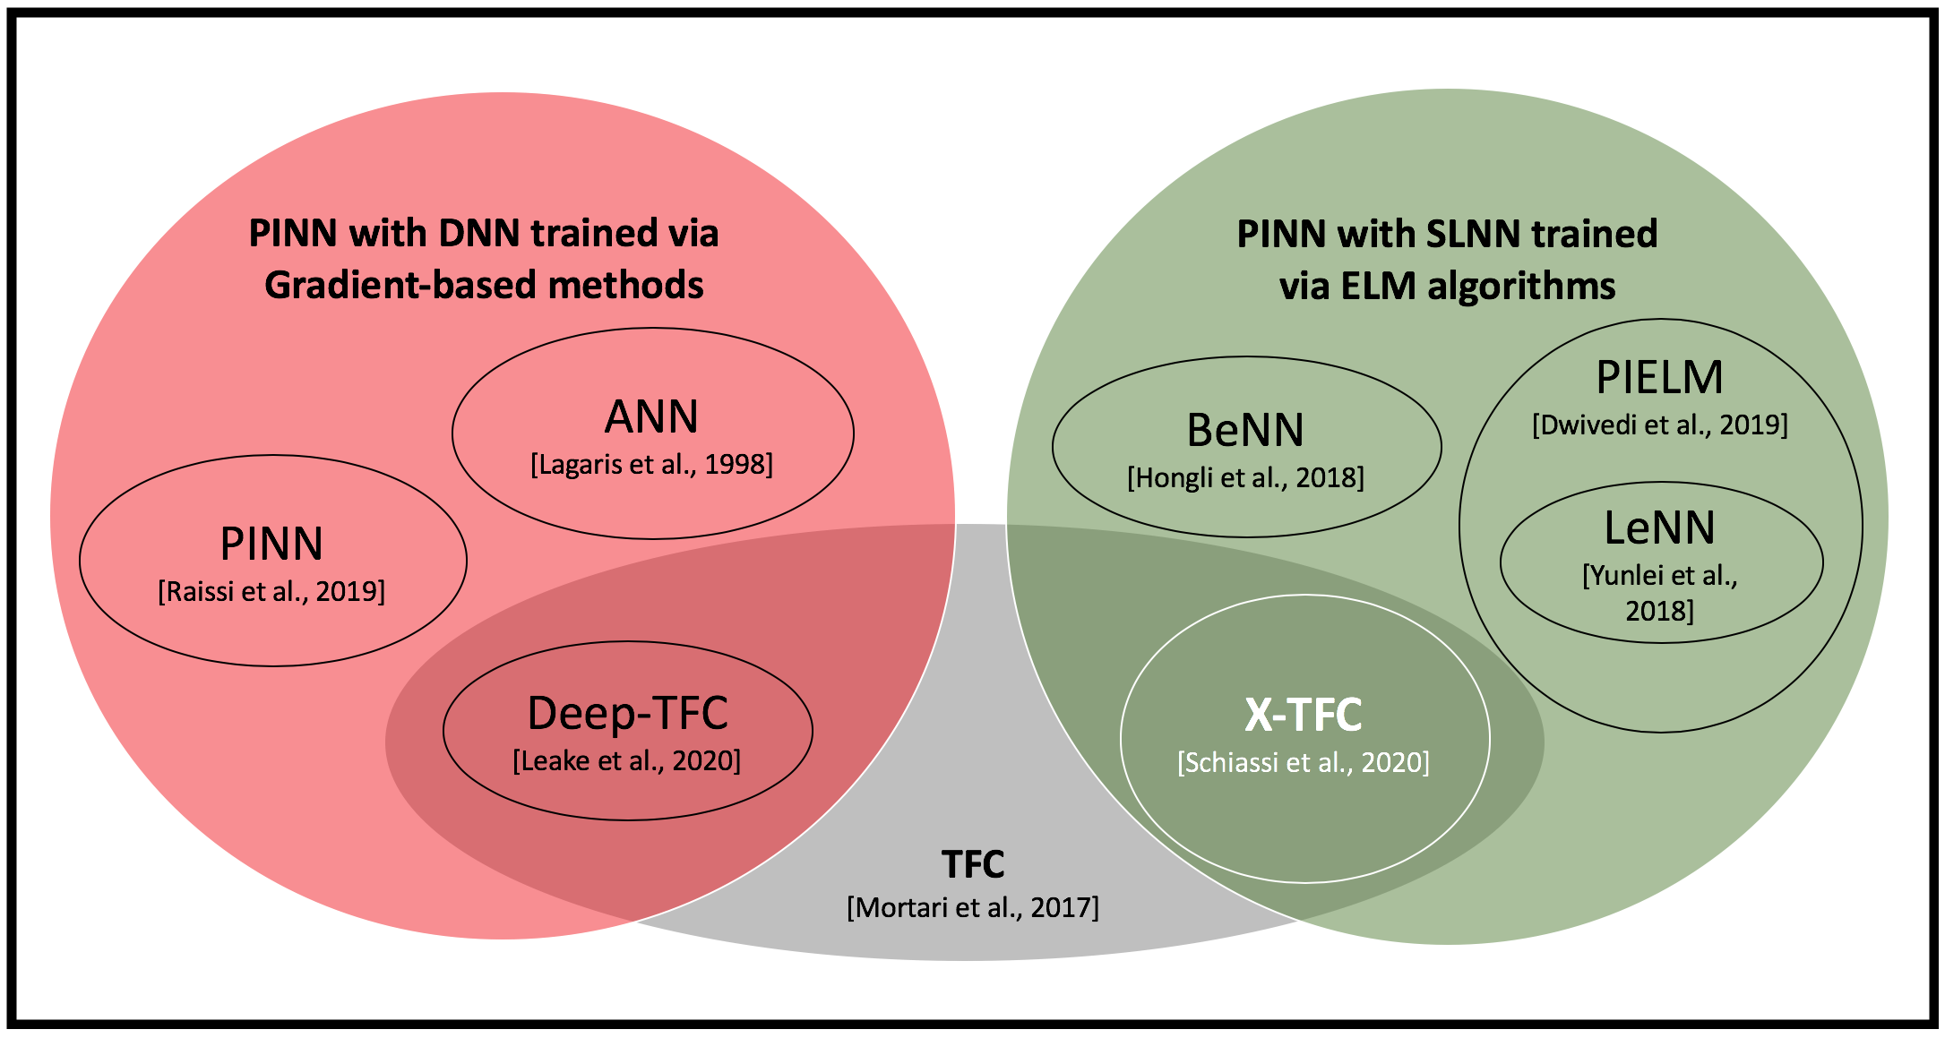
Introduction: Goal
Our goal is to develop a Physics–Informed Framework, called Extreme Theory of Functional Connections (X-TFC) that is a synergy of the TFC and the standard PINN methods
    X-TFC uses the TFC constrained expression where the free-chosen function is a Single Layer Feedforward NN (SLNN) trained via Extreme Learning Machine (ELM) Algorithm [Huang et al., 2006]

Slide 7
Contents
  Introduction
    Overview
    Goals
  Extreme Theory of Functional Connection
    Method
    Constrained Expression
    Extreme Learning Machine Algorithm
  Results and Discussion
    ODEs
    PDEs
  Conclusions and Outlooks

Slide 8
X-TFC: Method
    Consider a parametric DE written in its most general implicit form
    Approximate the latent solution with a constrained expression
    The free-chosen function is a SLNN trained via ELM
    The unknowns become the output weights (and the DE parameters)

Slide 9
X-TFC: Method (cont’d)
    Define, the loss,
    Defined the Mean Square Errors (MSEs)
    Unconstrained Optimization Problem for Data-Driven discovery of DEs
    Unconstrained Optimization Problem for Direct solution of DEs
    , where

Slide 10
X-TFC: Constrained Expression
    A general n+1 dimensional constrained expression is:
    x is the vector of the n+1 independent variables
    M is an (n+1)^{th} order tensor containing
      c(x) are the BCs
      v’s are expressions whose elements are function of the independent variables
      g(x) is the free-chosen function

Slide 11
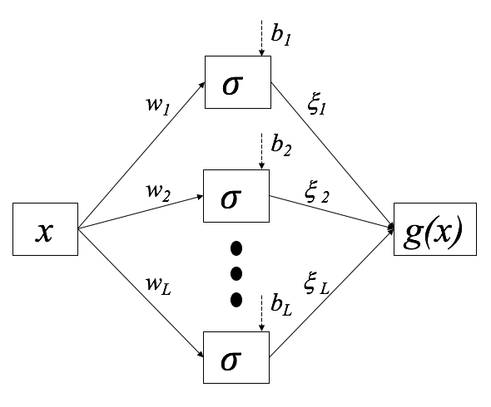
X-TFC: ELM Algorithm
  ELM is a training algorithm for SLNN that randomly selects input weights and bias, and computes the output weights via least-square
    Input weights and bias are not tuned during the training
  The convergence of the ELM algorithm is proved by Huang et al. [2006]
    The convergence is guaranteed for any input weights and bias randomly chosen to any continuous probability distribution

Slide 12
Contents
  Introduction
    Overview
    Goals
  Extreme Theory of Functional Connection
    Method
    Constrained Expression
    Extreme Learning Machine Algorithm
  Results and Discussion
    ODEs
    PDEs
  Conclusions and Outlooks

Slide 13
Results and Discussion: ODEs-P1
  Equation:
  Activation Function: Logistic
  Number of Points: 50
  Number of Neurons: 50
  Input Weights and Biased sampled from: unif [-10,10]
  Iterations to Convergence: 4
  Computational Time: ~ 0.8 [ms]
  Constraints:
  Exact Solution:
  CE:

Slide 14
Results and Discussion: PDEs-P1
  Equation:
  Activation Function: Hyperbolic Tangent
  Number of Points per variable: 30
  Number of Neurons: 170
  Input Weights and Biased sampled from: unif [-1,1]
  Computational Time: ~ 8.1 [ms]
  Average Training Error: ~ 6.5e-14
  Average Test Error: ~ 7.6e-14
  Constraints:
  Exact Solution:
  CE:
X-

Slide 15
Results and Discussion: PDEs-P2
  Equation (2D time dep. Heat Eq.):
  Activation Function: Hyperbolic Tangent
  Number of Points per variable: 13
  Number of Neurons: 400
  Input Weights and Biased sampled from: unif [-1,1]
  Computational Time: ~ 55 [ms]
  Average Training Error: ~ 2e-5
  Max Training Error: ~ 4e-4
  Average Test Error: ~ 2e-5
  Max Test Error: ~ 4e-4
  Constraints:
  Exact Solution:
  Where L=2, H=1, and k=1
  CE:

Slide 16
Results and Discussion: PDEs-P3
  Equation (3D time dep. non-linear):
  Activation Function: Hyperbolic Tangent
  Number of Points per variable: 5
  Number of Neurons: 340
  Input Weights and Biased sampled from: unif [-1,1]
  Iterations to Convergence: 10
  Computational Time: ~ 0.23 [s]
  Average Training Error: ~ 7e-7
  Max Training Error: ~ 3e-5
  Average Test Error: : ~ 8e-7
  Max Test Error: ~ 3e-5
  Constraints:
  Exact Solution:
  CE:

Slide 17
Results and Discussion: Sensitivity Analysis
  Activation Function: Logistic
  Number of Neurons: 100
  Input Weights and Biased sampled from: unif [-10,10]
  Activation Function: Logistic
  Number of Points: 100
  Input Weights and Biased sampled from: unif [-10,10]
  ODE-P1

Slide 18
Contents
  Introduction
    Overview
    Goals
  Extreme Theory of Functional Connection
    Method
    Constrained Expression
    Extreme Learning Machine Algorithm
  Results and Discussion
    ODEs
    PDEs
  Conclusions and Outlooks

Slide 19


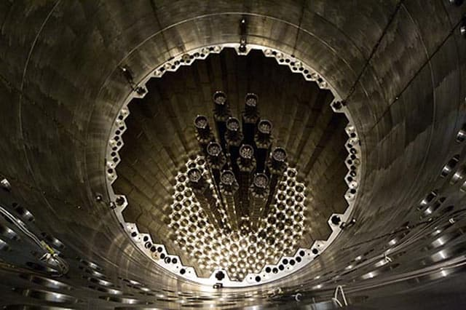

Conclusions and Outlooks
  We developed a new fast, accurate, and robust physics-informed NN framework, X-TFC, to solve problems involving parametric ODEs and PDEs
    Synergy of TFC and standard physics-informed NN methods
  The X-TFC method can be used to tackle direct problems and data-driven discovery of problems involving DEs
  Future works will focus on the application of this new physics-informed method to problems in different fields such as
    Optimal control for space guidance
    Remote sensing for Earth systems characterization and space exploration
    Neutron Transport Theory for nuclear reactors, design and control
    Data-driven parameters discovery of epidemiological compartmental models

Slide 20
References
D. Mortari, “The Theory of Connections: Connecting Points,” MDPI Mathematics, vol. 5, no. 57, 2017.
M. Raissi, P. Perdikaris, and G. E. Karniadakis, “Physics-informed neural networks: A deep learning framework for solving forward and inverse problems involving nonlinear partial differential equations,” Journal of Computational Physics, vol. 378, pp. 686–707, 2019
C. Leake and D. Mortari, “Deep Theory of Functional Connections: A New Method for Estimating the Solutions of Partial Differential Equations,” Machine Learning and Knowledge Extraction, vol. 2, no. 1, pp. 37–55, 2020.
G.-B. Huang, Q.-Y. Zhu, and C.-K. Siew, “ Extreme learning machine: Theory and applications ,” Neurocomputing, vol. 70, pp. 489–501, May 2006.
Y. Yang, M. Hou, and J. Luo, “A novel improved extreme learning machine algorithm in solving ordinary differential equations by Legendre neural network methods,” Advances in Difference Equations, vol. 2018, no. 1, p. 469, 2018.
I. E. Lagaris, A. Likas, and D. I. Fotiadis, “Artificial neural networks for solving ordinary and partial differential equations,” IEEE Transactions on Neural Networks, vol. 9, pp. 987–1000, Sept 1998.
D. Vikas and S. Balaji, “Physics-Informed Extreme Learning Machine (PIELM)- A Rapid Method For The Numerical Solution Of Partial Differential Equations,” arXiv, vol. Xiv:1907.03507v1, 2019.
H. Sun, M. Hou, Y. Yang, T. Zhang, F. Weng, and F. Han, “Solving Partial Differential Equation Based on Bernstein Neural Network and Extreme Learning Machine Algorithm,” Neural Processing Letters, vol. 50, no. 2, pp. 1153–1172, 2019.
Enrico Schiassi, Carl Leake, Mario De Florio, Hunter Johnston, Roberto Furfaro, and Daniele Mortari, Extreme Theory of Functional Connections: A Physics-Informed Method For Solving Parametric Differential Equations, arXiv (pending approval), 2020.

Slide 21



The AZ-TZ Team
Enrico Schiassi, PhD student, Systems and Industrial Engineering, The University of Arizona, Tucson, AZ, USA
Carl Leake, PhD student, Aerospace Engineering, Texas A&M University, College Station, TX, USA
Mario De Florio, PhD student, Systems and Industrial Engineering, The University of Arizona, Tucson, AZ, USA
Hunter Johnston, PhD student, Aerospace Engineering, Texas A&M University, College Station, TX, USA
Roberto Furfaro, Professor, Systems and Industrial Engineering & Aerospace and Mechanical Engineering, The University of Arizona, Tucson, AZ, USA
Daniele Mortari, Professor, Aerospace Engineering, Texas A&M University, College Station, TX, USA

Slide 22

Q-Time ???
THANKS FOR YOUR ATTENTION

